Slide 1
HEALTHCARE STROKE DATASET
BY Akhilesh Mishra

Slide 2
What is stroke
A stroke is a medical emergency.
Symptoms of stroke include trouble walking, speaking and understanding, as well as paralysis or numbness of the face, arm or leg.
Early treatment with medication like tPA (clot buster) can minimise brain damage. Other treatments focus on limiting complications and preventing additional strokes.

Slide 3
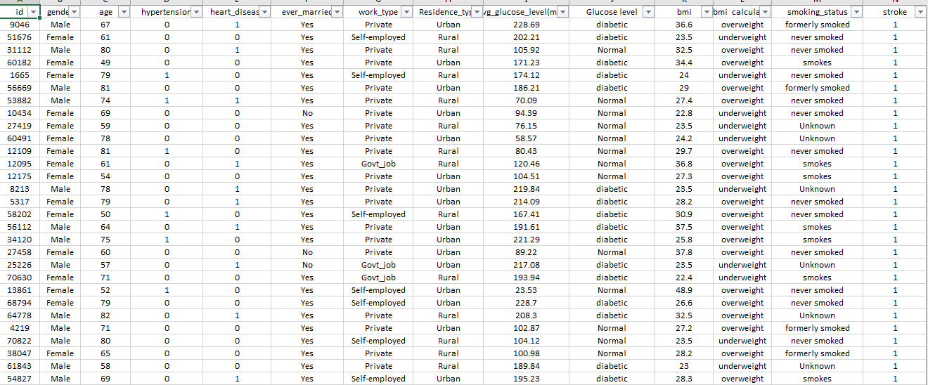
Sample of dataset

Slide 4
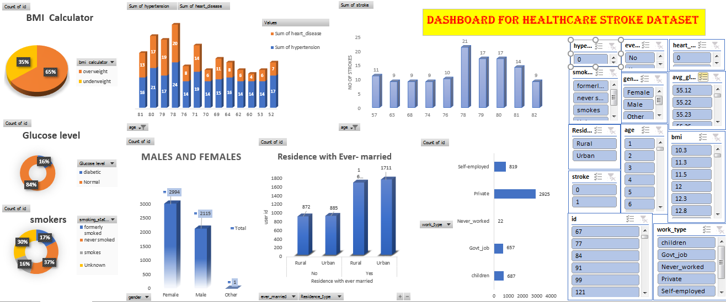
dashboard

Slide 5
Question and answer
Q1) HOW MANY USER WERE EVERMARRIED LIVING IN URBAN AREA? |  |  |  | 1711
Q2) HOW MANY USER WERE NOT EVERMARRIED LIVING IN RURAL AREA? |  |  |  | 872
Q3) HOW MANY PERSON WERE DIABATIC WITH PERCENTAGE? |  |  |  | 820,16%
Q4) HOW MANY PERSON WERE NORMAL WITH PERCENTAGE? |  |  |  | 4290,84%
Q5)WHICH AGE GROUP HAVE HIGHEST HYPERTENSION AND HEART DISEASE? |  |  |  | 78
Q6)IN WHICH SECTOR USER WORK MORE ? |  |  |  | PRIVATE WITH 2925
Q7)HOW MANY ARE GOVT JOB WORKER ? |  |  |  | 657
Q8)HOW MANY MALES AND FEMALE ARE THERE ? |  |  |  | M-2994,F-2115
Q9)HOW MANY USER SMOKES REGULARLY? |  |  |  | 789
Q10)HOW MANY USERS ARE UNDERWEIGHT? |  |  |  | 1781, 35%
Q11)AT WHICH AGE STROKES IS HIGH WITH LARGE AMOUNT? |  |  |  | 78

Slide 6
Residence with Ever- married

Slide 7
Glucose level of user id

Slide 8
hypertension and heart disease with age

Slide 9
work type of users

Slide 10
Total no males and females

Slide 11
Total no of smokers

Slide 12
BMI Calculator

Slide 13
top 10 No of Strokes with Age

Slide 14


